Slide 1
Finance Topic : Interoperability among Clearing Corporations
Prepared and presented By:
Nikhil Gaglani
Dy. Manager Angel Broking

Slide 2
Interoperability among Clearing Corporations
What is Interoperability among Clearing Corporations?
To allow market participants to consolidate their clearing and settlement functions at a single Clearing Corporations
Interoperability is a mechanism by which one clearing corporation could be used to execute and settle trades of any exchange

Slide 3
Interoperability among Clearing Corporations
Key Players
NSE > National Stock Exchange Clearing Corporation Ltd and
BSE> Indian Clearing Corporation, should be allowed to interoperate as they meet the minimum capital requirement.
Metropolitan Clearing Corporation Ltd

Slide 4
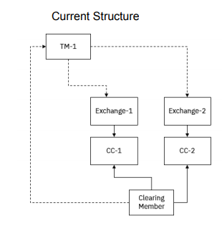
Structure of Clearing Corporation (CC)
Current Model :
Under the current framework, the exchanges and clearing corporations operate under a vertically integrated model wherein the clearing and settlement of trades executed on an exchange is done by a dedicated and single clearing corporation.
Trading members trading on multiple exchanges need to make arrangements for clearing with clearing corporations of respective exchanges,
Need to clear and settle deals with the clearing corporations of respective exchanges separately.
Dis Advantage of Current Model
The current model hinders competition among exchanges.
It favours the monopoly platform and makes it expensive for traders to take positions.
This vitiates increased participation as the current model requires traders to finance multiple margin requirements.
It is the reason for loss of market share for exchanges such as the BSE.

Slide 5
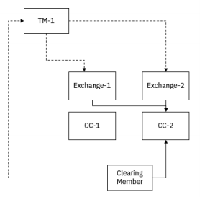
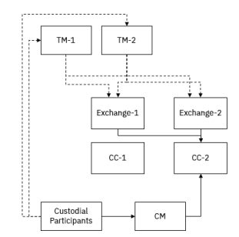
Structure of Clearing Corporation (CC) Interoperability
Under CC Interoperability, a Clearing Member may maintain association with a single clearing corporation.
The trades executed on multiple exchanges can be consolidated into a single Clearing Corporation for the clearing member
No strict one-to-one association of exchanges and clearing corporations.
The trades for custodial participants trading through multiple trading members but clearing through a single clearing member may also be cleared by the clearing member with a single clearing corporation.

Slide 6
Products covered under Clearing Corporation (CC) Interoperability
All products under the Cash Market Segment, F&O Segment, Currency Derivatives Segment (including Interest Rate derivatives), and Debt Segment (except Tri-party Repo and Trade Reporting Platform) will be covered under CC Interoperability.
The interoperability arrangement will be applicable for exchange traded products only.
The Order collection mechanisms/schemes such as Offer for Sale, Mutual Funds Service Scheme, Buy-back/Tender Offer schemes, Non-competitive bidding, Primary bidding of SGB etc. are not covered under interoperability.
Securities Lending and Borrowing Scheme is not included under interoperability since the scheme is operated by Clearing Corporation as an Approved Intermediary

Slide 7
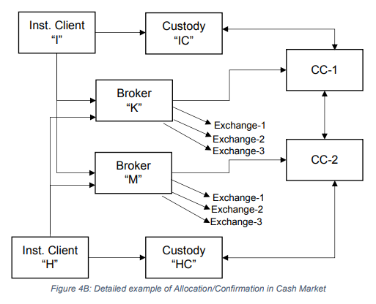
Interoperability among Clearing Corporations
Allocation and confirmation process in cash market
“Allocating Clearing Corporation (Allocating CC)” > clearing corporation through which the clearing member of the trading member executing the trade is clearing the trades.
“Confirmation Clearing Corporation (Confirmation CC)” > clearing corporation through which the custodian of the custodial participant involved is clearing the trades.
Institutional client “I” is associated with custody “IC” who has designated CC-1.
The client “I” trades through brokers “K” and “M”, who are SCMs and have designated CC-1 and CC-2 respectively. The client “I” may trade on all exchanges through each of the brokers.
Institutional client “H” is associated with custody “HC” who has designated CC-2.
Client “H” also trades through brokers “K” and “M”
Allocation Process
Allocation CC will be as per the CC mapped to the executing broker. In this example “K” will perform allocation at CC-1 and “M” will perform allocation at CC-2; regardless of the exchange on which the trades are executed.
The allocation will be done by “K” and “M” using the allocation facility provided by each CC, the manner, file structures etc. will be as per the facility of the CC, regardless of the exchange where the trade is executed.
Confirmation and rejection
Confirmation will be done by the custodian using the facility provided by confirmation CC. In this example, “IC” will confirm trades of “I” executed by both “K” and “M” in all the exchanges, using the confirmation facility provided by CC-1.
Trades once confirmed cannot be rejected or vice-versa.

Slide 8
Advantage of Interoperability
Interoperability gives flexibility to trade a security on multiple platforms and yet settle it at one place, thereby cutting margin requirements
To interoperate, the CCPs arrange to pool in cash and collateral among themselves so that one user can execute or clear trades with a counterparty of the other CCP.
When users direct their trades for clearing by a single CCP, regardless of where it was executed, it reduces risk and cuts cost.
large funds is managed centrally, making the overall system immune to risks.
Interoperability can boost volumes as consistency of clients to trade across exchanges will widen the market
Fewer procedures and movements of cash and securities due to pooling will cut operational risks.

Slide 9
Collateral and Risk Management
The clearing members shall maintain the collateral at clearing corporation(s) based on the model for choice of interoperability.
The collateral deposited at a CC for a given segment will be used for the margin requirements based on the transactions cleared through the CC in the respective segment as per current process; regardless of the exchange on which the trades are executed.
When the clearing corporations decide to place a trading/clearing member in Risk Reduction (RR)/Closeout mode, the clearing corporations will notify all exchanges and all exchanges will act on such instructions

Slide 10
Source:
Interoperability among Clearing Corporations (Draft Operating Guidelines Jointly issued by Indian Clearing Corporation Ltd., Metropolitan Clearing Corporation Ltd., NSE Clearing Ltd.)

